Slide 1


SIMATS ENGINEERING Saveetha Institute of Medical and Technical Sciences Chennai-602105.
ONLINE POLLING SYSTEM WITH INSTANT RESULT DISPLAY
Presentation By: Sayed Fazal 192311291
Supervisor: Dr. L. Reetha

Slide 2

AIM:
To develop an Online Polling System with Instant Results Display that allows users to vote digitally and view real-time poll results securely, efficiently, and transparently.
ABSTRACT:
The Online Polling System is a web-based application designed to conduct digital polls or elections in a secure, user-friendly environment.
It allows registered users to log in, cast their votes, and instantly view the real-time results of the poll.
Built using HTML, CSS for frontend and PHP with MySQL for backend, the system ensures real-time interaction and secure data handling.

Slide 3
INTRODUCTION:
Voting is a fundamental part of decision-making in any group or organization.
Traditional voting methods are time-consuming, prone to errors, and lack real-time result updates.
An online polling system automates the voting process and ensures transparency and efficiency.
ALGORITHM:
Step 1: User opens the website and registers(New user) or login in with valid credentials. Step 2: System verifies login details from the database. Step 3: Upon successful login, the user is presented with the available polls. Step 4: User selects a candidate/option and submits the vote. Step 5: System checks if the user has already voted (to prevent duplicates). Step 6: If valid, the vote is stored in the database. Step 7: Vote count is updated and instant result display is refreshed.

Slide 4
FLOW DIAGRAM
Block Vote/ Show Message
END
No
Already Voted?
START
User Login Page
Check Credentials
Yes
Display Poll Options
END
Update and Display Live Results
User Vote in Database

Slide 5
PSEUDOCODE
Login Form: <form action="api/login.php" method="POST">
<input type="number" name="mobile" placeholder="Enter Mobile Number" required>
<input type="password" name="password" placeholder="Enter Password" required>
<select name="role" required>
<option value="1">Voter</option>
<option value="2">Group</option>
</select>
<button type="submit">Login</button>
</form>
Registration Form: <form action="../api/register.php" method="POST" enctype="multipart/form-data">
<input type="text" name="name" placeholder="Enter Name">
<input type="number" name="mobile" placeholder="Enter mobile">
<input type="password" name="password" placeholder="Password">
<input type="password" name="cpassword" placeholder="Confirm Password">
</form>
Address, Image & Role: <input type="text" name="address" placeholder="Address">
<b>Upload Image:</b>
<input type="file" name="photo">
<select name="role">
<option value="1">Voter</option>
<option value="2">Group</option>
</select>
Register Button & Login Link:
<button type="submit" class="register-btn">Register</button>
<span><b>Already a user?</b> <a href="../index.html">Login Here</a></span>
User Input:
$mobile = $_POST['mobile'];
$password = $_POST['password'];
$role = $_POST['role’];
Validate User:
$check = mysqli_query($connect,
"SELECT * FROM user WHERE mobile='$mobile' AND password='$password' AND role='$role'");
If Valid - Set Sessions:
$userdata = mysqli_fetch_array($check, MYSQLI_ASSOC);
$groups = mysqli_query($connect, "SELECT * FROM user WHERE role=2");
$_SESSION['userdata'] = $userdata;
$_SESSION['groupsdata'] = mysqli_fetch_all($groups, MYSQLI_ASSOC);
header("Location: ../routes/dashboard.php");

Slide 6
PSEUDOCODE
Handle Image Upload: $image = $_FILES['photo']['name'];
$tmp_name = $_FILES['photo']['tmp_name'];
move_uploaded_file($tmp_name, "../uploads/$image");
Insert Into Database:
$insert = mysqli_query($connect,
"INSERT INTO user (name, mobile, address, password, photo, role, status, votes)
VALUES ('$name', '$mobile', '$address', '$password', '$image', '$role', 0, 0)");
Display Voting Groups: foreach ($groupsdata as $group) {
$groupName = htmlspecialchars($group['name']);
$groupVotes = (int)$group['votes'];
$groupId = (int)$group['id'];
...
}
Voting Form Logic :
<form action="../api/vote.php" method="POST">
<input type="hidden" name="gvotes" value="<?php echo $groupVotes; ?>">
<input type="hidden" name="gid" value="<?php echo $groupId; ?>">
<?php if ($userdata['status'] == 0): ?>
<input type="submit" value="Vote" id="votebtn">
<?php else: ?>
<button disabled id="voted">Voted</button>
<?php endif; ?>
</form>
User Status & Profile Image:
$photoPath = "../uploads/" . $userdata['photo'];
$status = ($userdata['status'] == 0)
? '<b style="color: red">Not voted</b>'
: '<b style="color: green">Voted</b>’;
Display User Profile:
<img src="<?php echo htmlspecialchars($photoPath); ?>" height="100">
<b>Name:</b> <?php echo htmlspecialchars($userdata['name']); ?><br>
<b>Mobile:</b> <?php echo htmlspecialchars($userdata['mobile']); ?><br>
<b>Status:</b> <?php echo $status; ?>

Slide 7
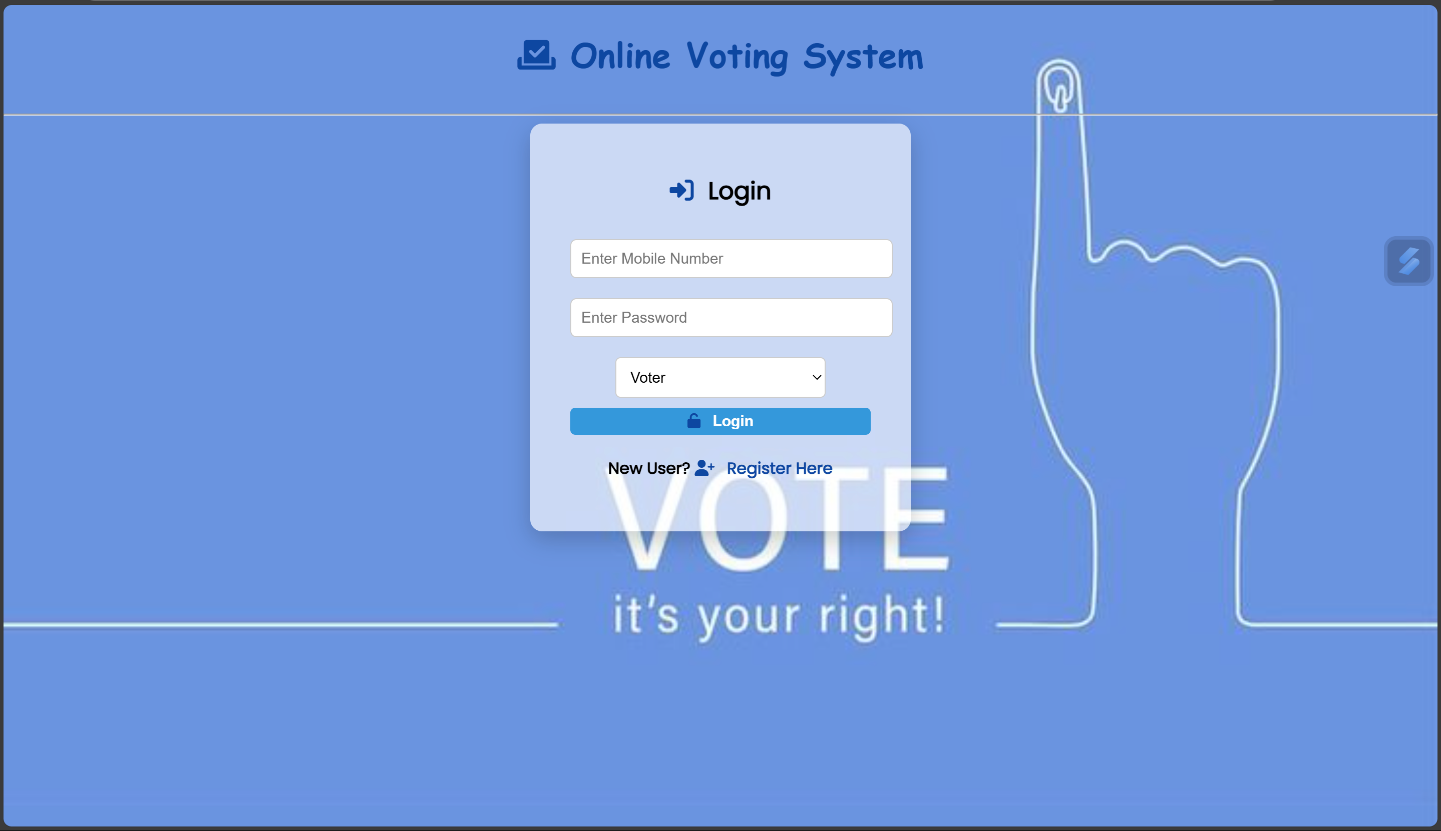
INPUT/OUTPUT
Fig1: Login Page

Slide 8
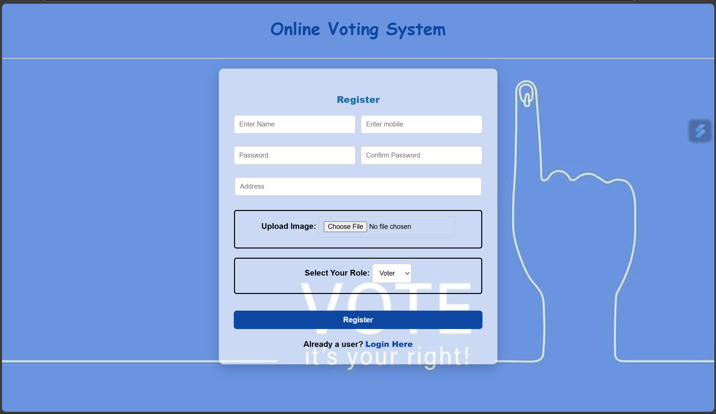
INPUT/OUTPUT
Fig2: Registration Page

Slide 9
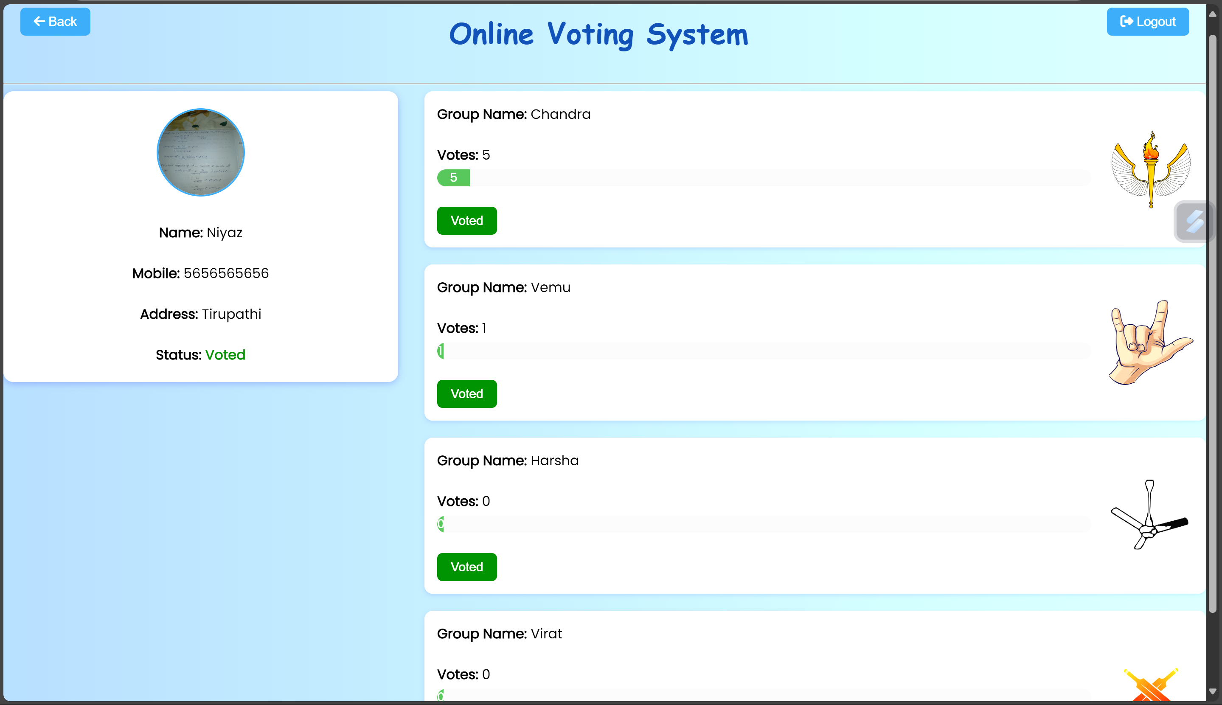
INPUT/OUTPUT
Fig3: Dashboard Page

Slide 10
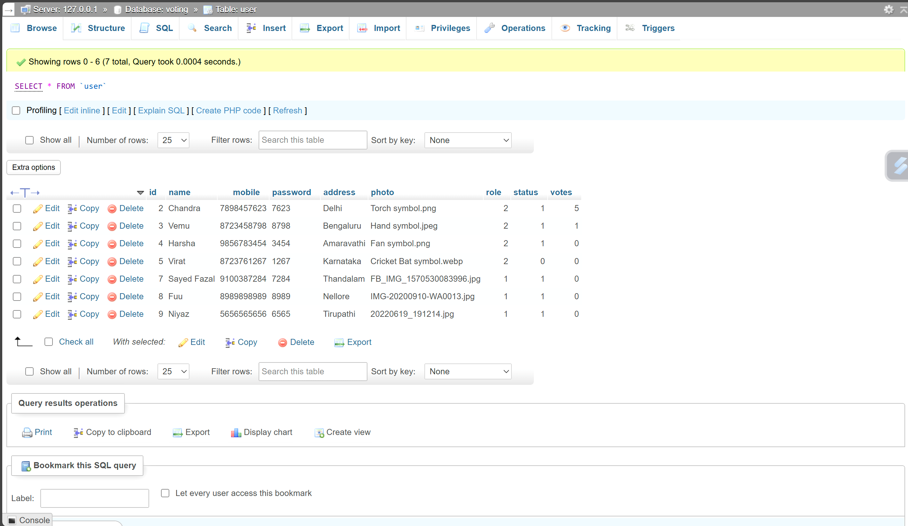
INPUT/OUTPUT
Fig4: Backend Data

Slide 11
REFERENCES
Welling, Luke, and Thomson, Laura. PHP and MySQL Web Development. Addison-Wesley, 2016.
Duckett, Jon. HTML and CSS: Design and Build Websites. Wiley, 2011.
PHP Official Documentation – https://www.php.net/docs.php
MySQL Official Documentation – https://dev.mysql.com/doc/
W3Schools – https://www.w3schools.com
Stack Overflow – https://stackoverflow.com

Slide 12
RESULT ANALYSIS
Successful Login & Role-Based Redirection:
Voters and Groups (Admins) are redirected to separate dashboards based on their selected role.
Invalid login attempts are correctly handled with user-friendly alerts.
Real-Time Vote Casting & Status Update:
Once a vote is cast, the voter's status immediately updates to "Voted".
The voting button gets disabled to prevent multiple votes by the same user.
Dynamic Vote Count Display:
Group login dashboards reflect live vote counts for each candidate or group.
Voter dashboards restrict vote count visibility to maintain anonymity and fairness.
File Upload & Image Rendering:
User and group photos are correctly uploaded and displayed on the dashboard.
Styling ensures profile/group images are neatly aligned and sized.

Slide 13
Thank You

